Slide 1
Maxent Models and Discriminative Estimation
The maximum entropy model presentation
Notes:
Chris: 1-24; Dan 25-49; Dan 50-75; Chris 77-96

Slide 2
Maximum Entropy Models
An equivalent approach:
Lots of distributions out there, most of them very spiked, specific, overfit.
We want a distribution which is uniform except in specific ways we require.
Uniformity means high entropy – we can search for distributions which have properties we desire, but also have high entropy.
Ignorance is preferable to error and he is less remote from the truth who believes nothing than he who believes what is wrong – Thomas Jefferson (1781)

Slide 3
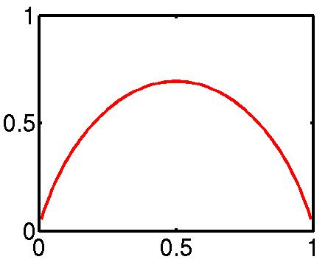
(Maximum) Entropy
Entropy: the uncertainty of a distribution.
Quantifying uncertainty (“surprise”):
Event x
Probability p_{x}
“Surprise” log(1/p_{x})
Entropy: expected surprise (over p):
H
p_{HEADS}
A coin-flip is most uncertain for a fair coin.
Notes:
Picture is mussed up. Maximum should be 1 for the coin flip!

Slide 4
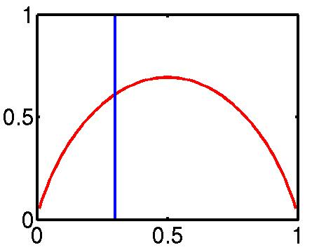
Maxent Examples I
What do we want from a distribution?
Minimize commitment = maximize entropy.
Resemble some reference distribution (data).
Solution: maximize entropy H, subject to feature-based constraints:
Adding constraints (features):
Lowers maximum entropy
Raises maximum likelihood of data
Brings the distribution further from uniform
Brings the distribution closer to data
Unconstrained, max at 0.5
Constraint that p_{HEADS} = 0.3

Slide 5
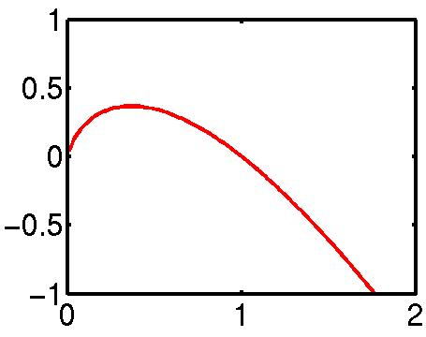
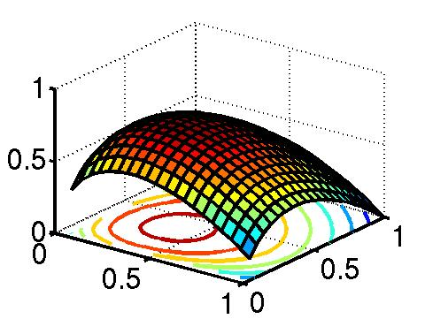
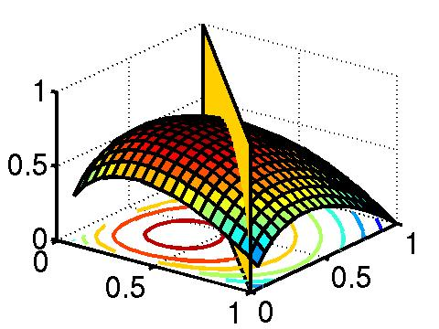
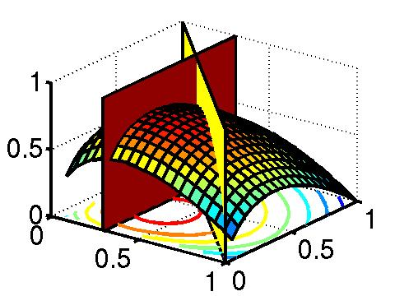
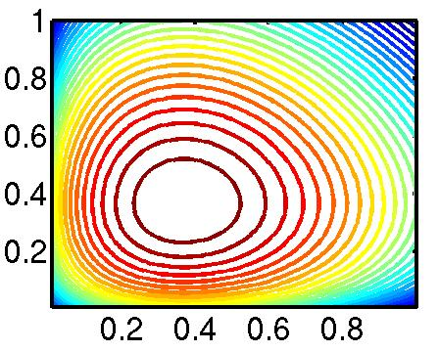
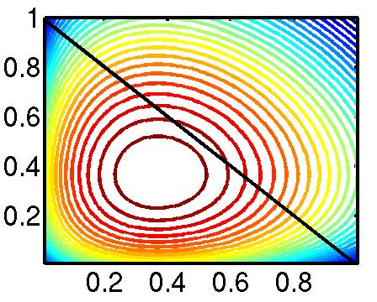
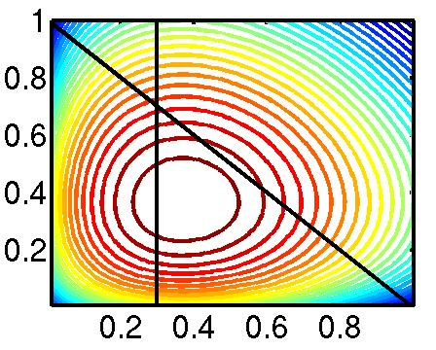
Maxent Examples II
1/e
- x log x
H(p_{H} p_{T},)
p_{H} + p_{T} = 1
p_{H} = 0.3

Slide 6
Maxent Examples III
Let’s say we have the following event space:
… and the following empirical data:
Maximize H:
… want probabilities: E[NN,NNS,NNP,NNPS,VBZ,VBD] = 1
NN | NNS | NNP | NNPS | VBZ | VBD
3 | 5 | 11 | 13 | 3 | 1
1/e | 1/e | 1/e | 1/e | 1/e | 1/e
1/6 | 1/6 | 1/6 | 1/6 | 1/6 | 1/6

Slide 7
Maxent Examples IV
Too uniform!
N* are more common than V*, so we add the feature f_{N} = {NN, NNS, NNP, NNPS}, with E[f_{N}] =32/36
… and proper nouns are more frequent than common nouns, so we add f_{P} = {NNP, NNPS}, with E[f_{P}] =24/36
… we could keep refining the models, e.g., by adding a feature to distinguish singular vs. plural nouns, or verb types.
NN | NNS | NNP | NNPS | VBZ | VBD
8/36 | 8/36 | 8/36 | 8/36 | 2/36 | 2/36
4/36 | 4/36 | 12/36 | 12/36 | 2/36 | 2/36

Slide 8
Convexity
Convex
Non-Convex
Convexity guarantees a single, global maximum because any higher points are greedily reachable.

Slide 9
Convexity II
Constrained H(p) = – ∑ x log x is convex:
– x log x is convex
– ∑ x log x is convex (sum of convex functions is convex).
The feasible region of constrained H is a linear subspace (which is convex)
The constrained entropy surface is therefore convex.
The maximum likelihood exponential model (dual) formulation is also convex.

Slide 10
Maxent Models and Discriminative Estimation
The maximum entropy model presentation
Notes:
Chris: 1-24; Dan 25-49; Dan 50-75; Chris 77-96

